Slide 1
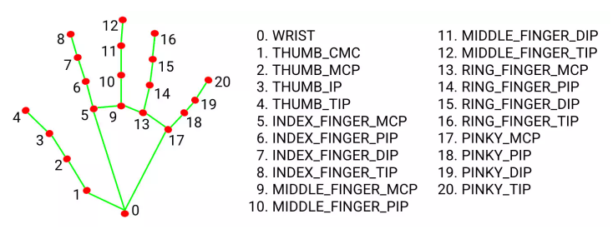
Angle Definition for Handmark Side View

